Slide 1
Render Portfolio for Populus Magos
a god game by Mario Battiston

Slide 2
TABLE OF CONTENTS
01
02
03
04
05
Brief Intro to Populus Magos
Each 3d Model rendered
Lighting
Camera (Isometric)
Scenes

Slide 3
01
Brief Intro to Populus Magos

Slide 4
Populus Magos
Story Intro
Game Summary
Populus Magos is a god game that takes inspiration from the great Populus 2 Trials of The Olympian Gods from developers Bullfrog Productions and publishers EA.
In the world of Populus Magos the Milky Way galaxy (our Galaxy) Stars are dying and the human colonies of the 21st Millenium are in peril of extinction. The Star Forgers is a Astra Faction that was formed in response the perils and they are tasked with traversing the exo-reaches for exo-planets that have been proven to have the resources necessary to reforge stars or forge new ones.
Magos is one such planet. And Magos is your mission. You are a Star Forge Astra Overseer of the Astra Formation 451 of the Star Forge Legion. Establish the Forgeworld, extract its Recources and Save our Stars!

Slide 5
02
Each 3d Model rendered

Slide 6
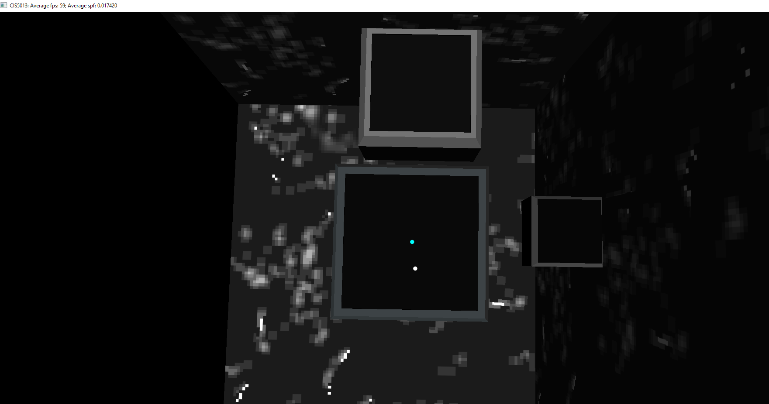
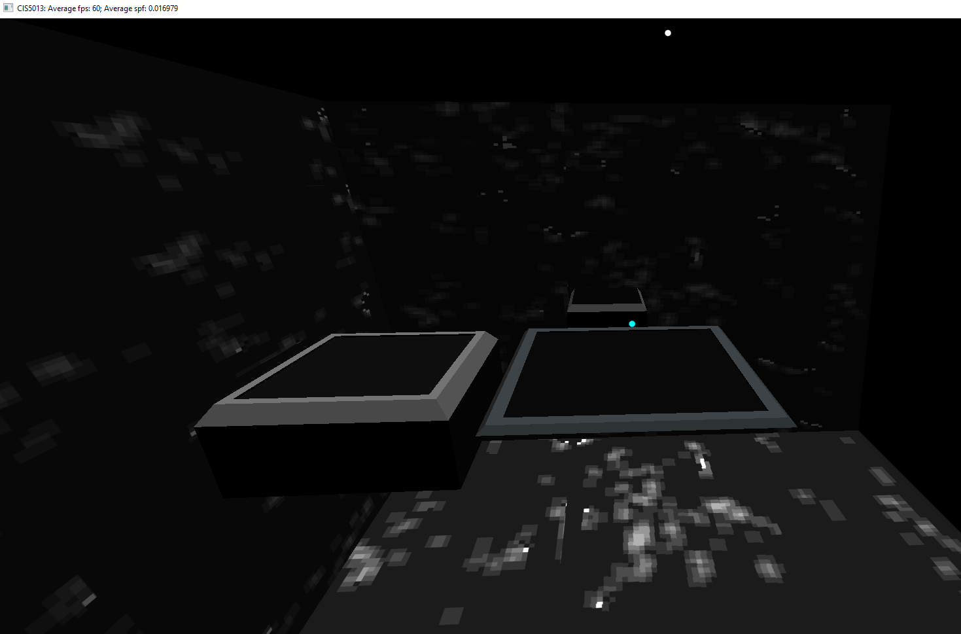
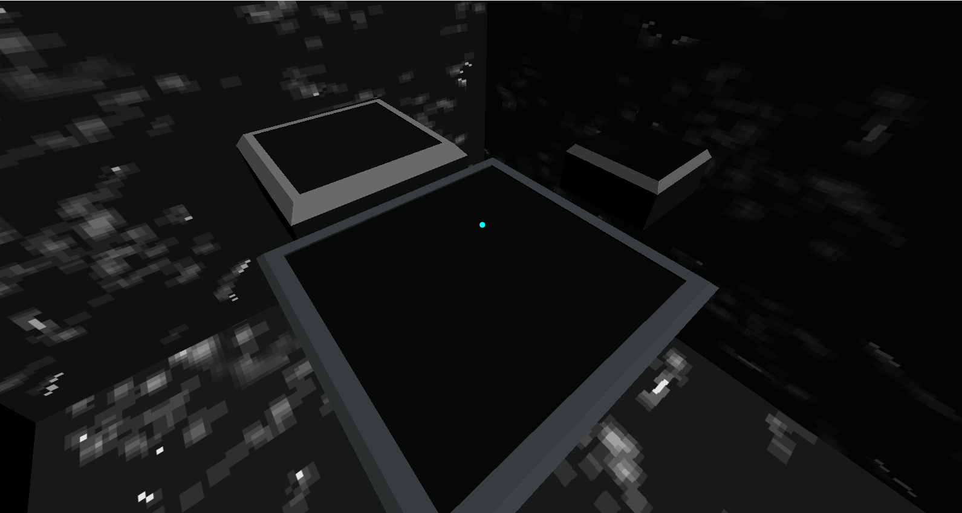
Terrain Board
Terrain Board
Main Ground plane where the game will play on
Map Board for the map and navigating where you are on the map.
Shrine board the board on which the shrine will be set upon. (This shrine will light different colors depending on if the player or enemy is winning acting as some visual communication)
Camera View

Slide 7
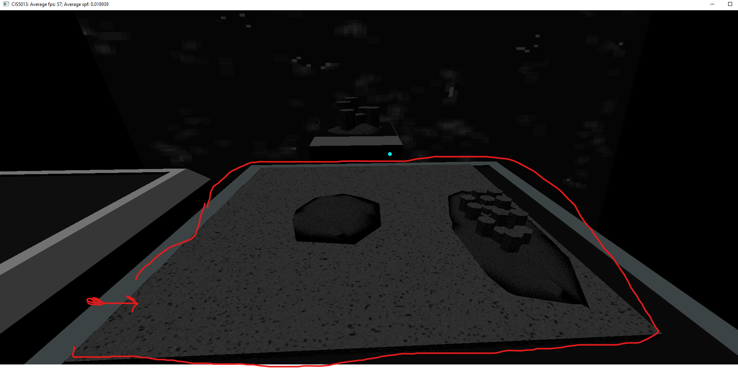
Ground Plane
Ground Plane

Slide 8
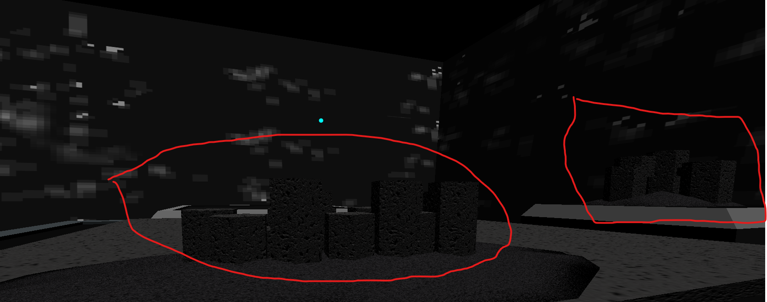
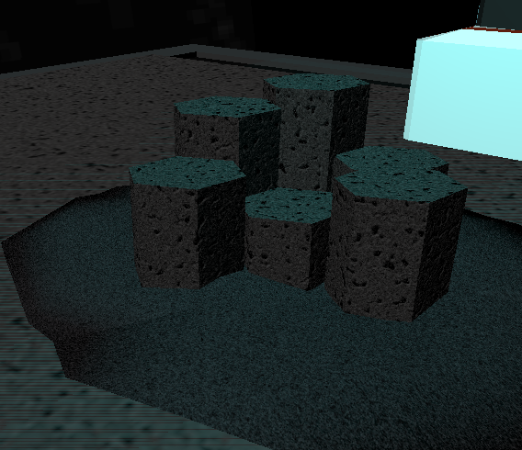
Single and Cluster Rock

Slide 9
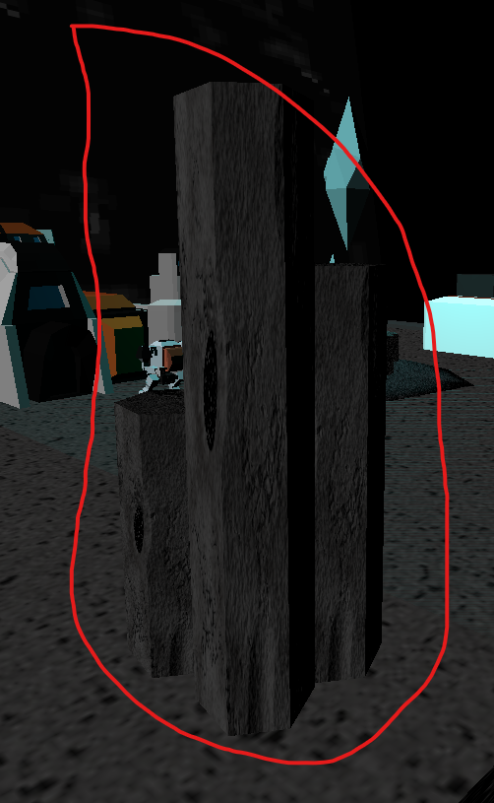
Single Rock

Slide 10
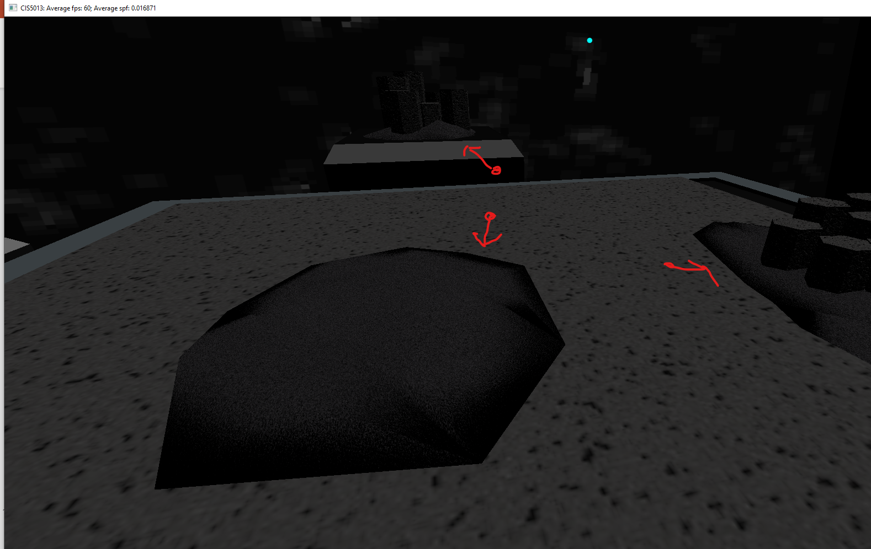
Ground Plane, Rock, Sand

Slide 11
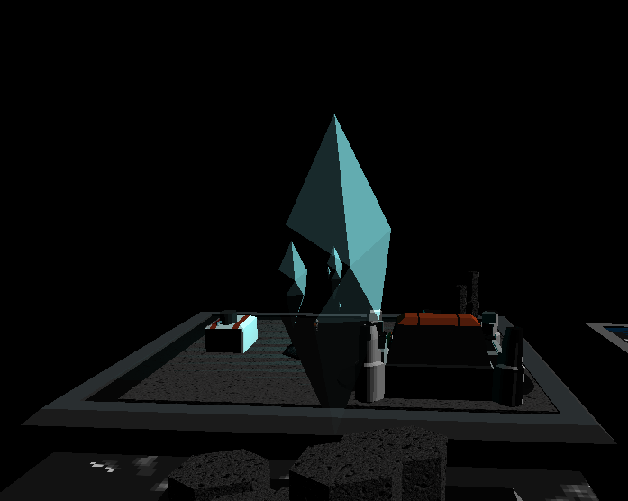
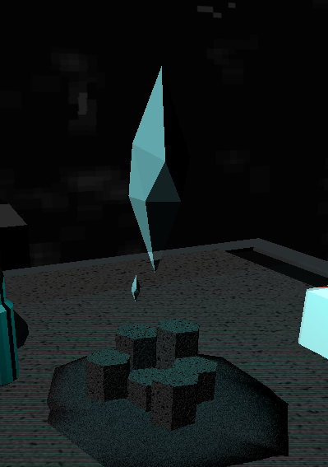
Crystal

Slide 12
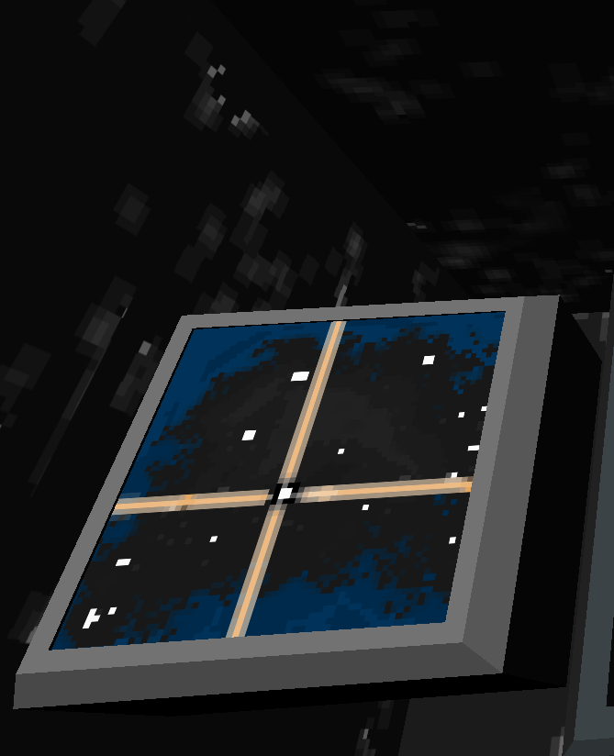
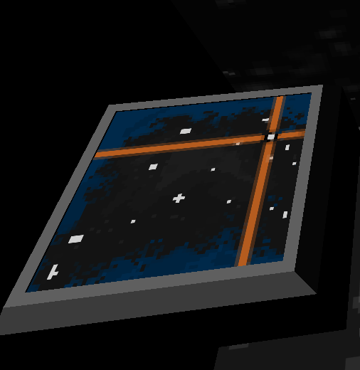
Maps

Slide 13
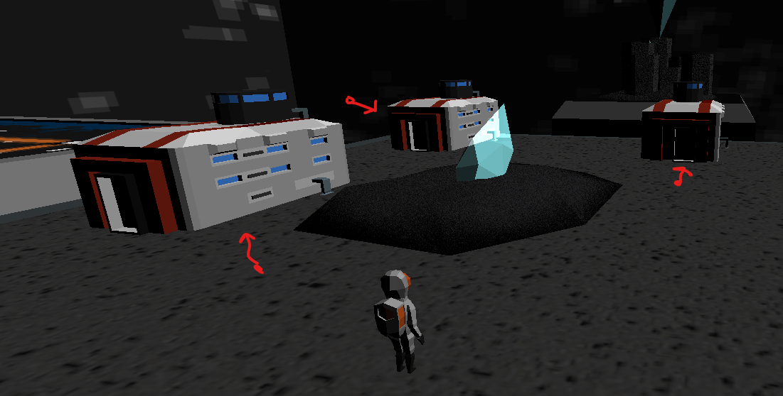
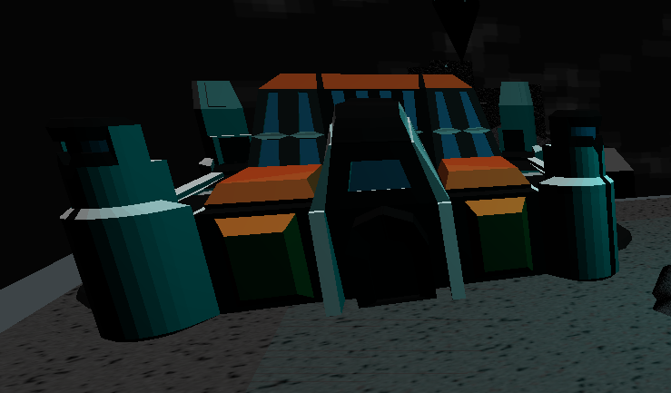
Astra Buildings

Slide 14
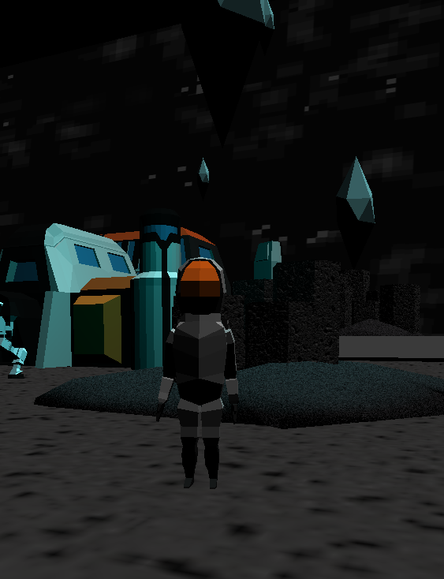
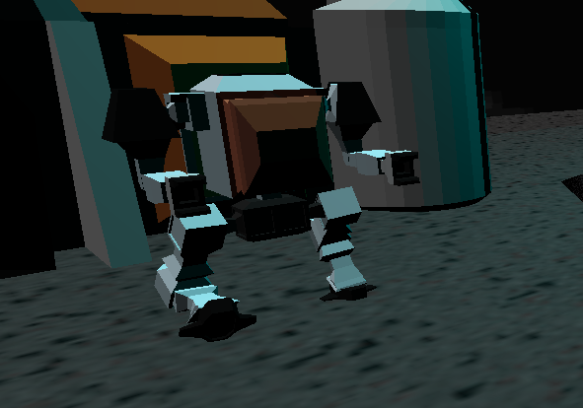
Star Forger & Star Walker

Slide 15
03
Lighting

Slide 16
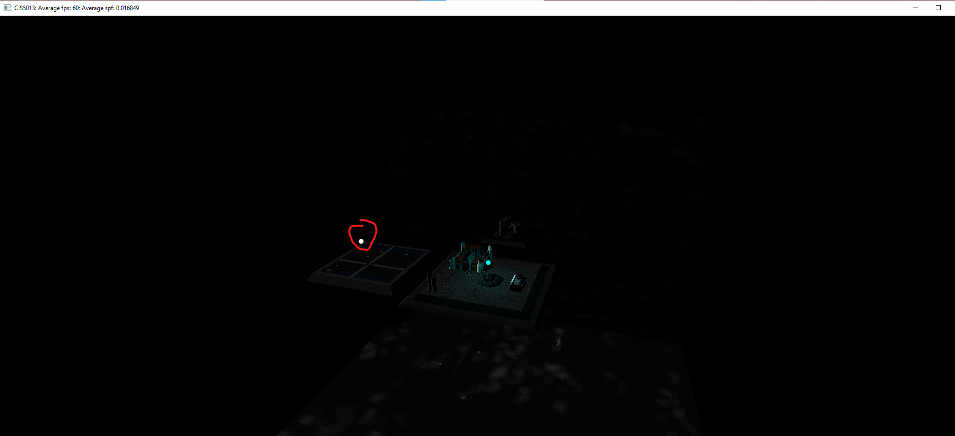
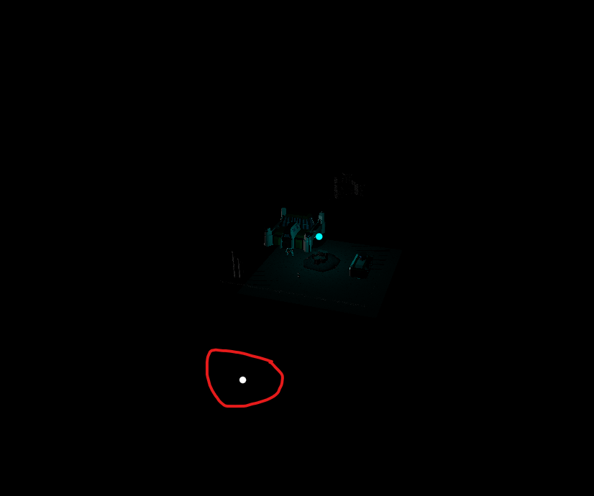
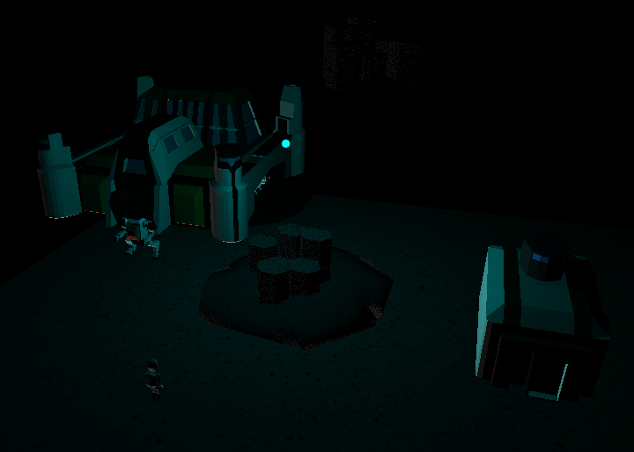
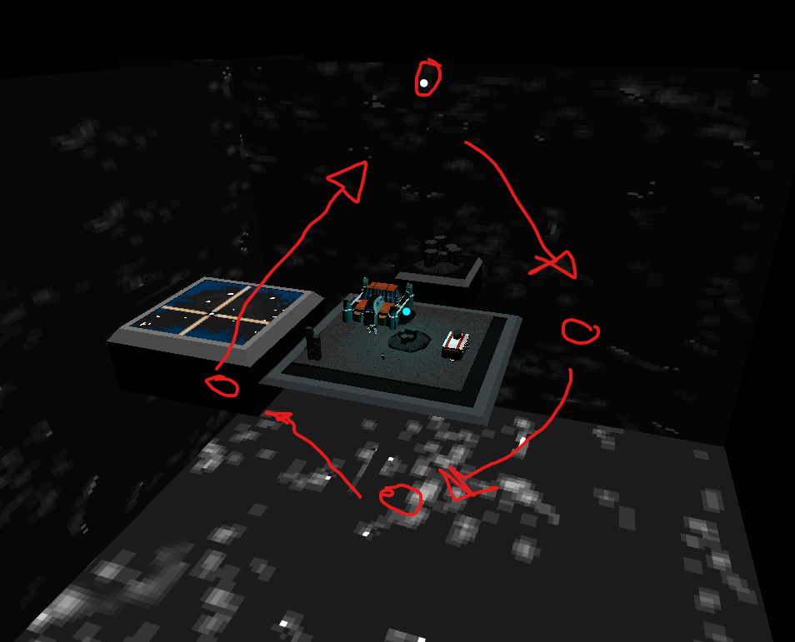
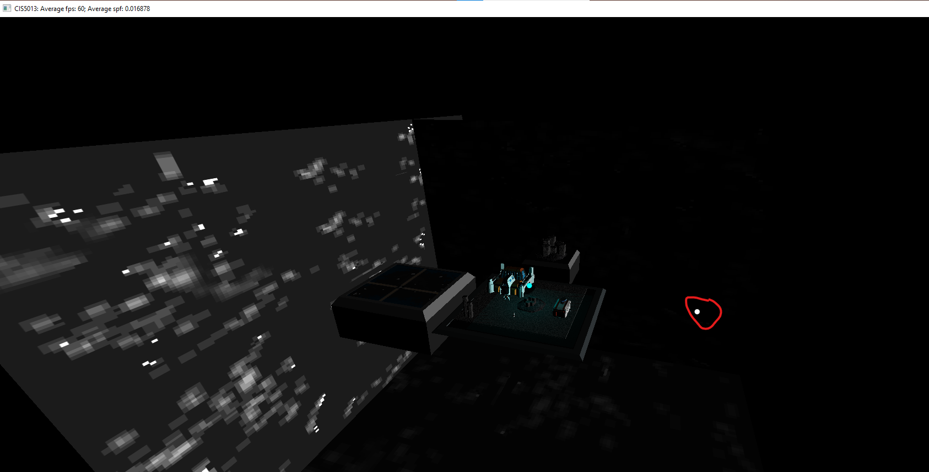
Directional Light Types

Slide 17
Point Light

Slide 18
04
Camera (Isometric)

Slide 19
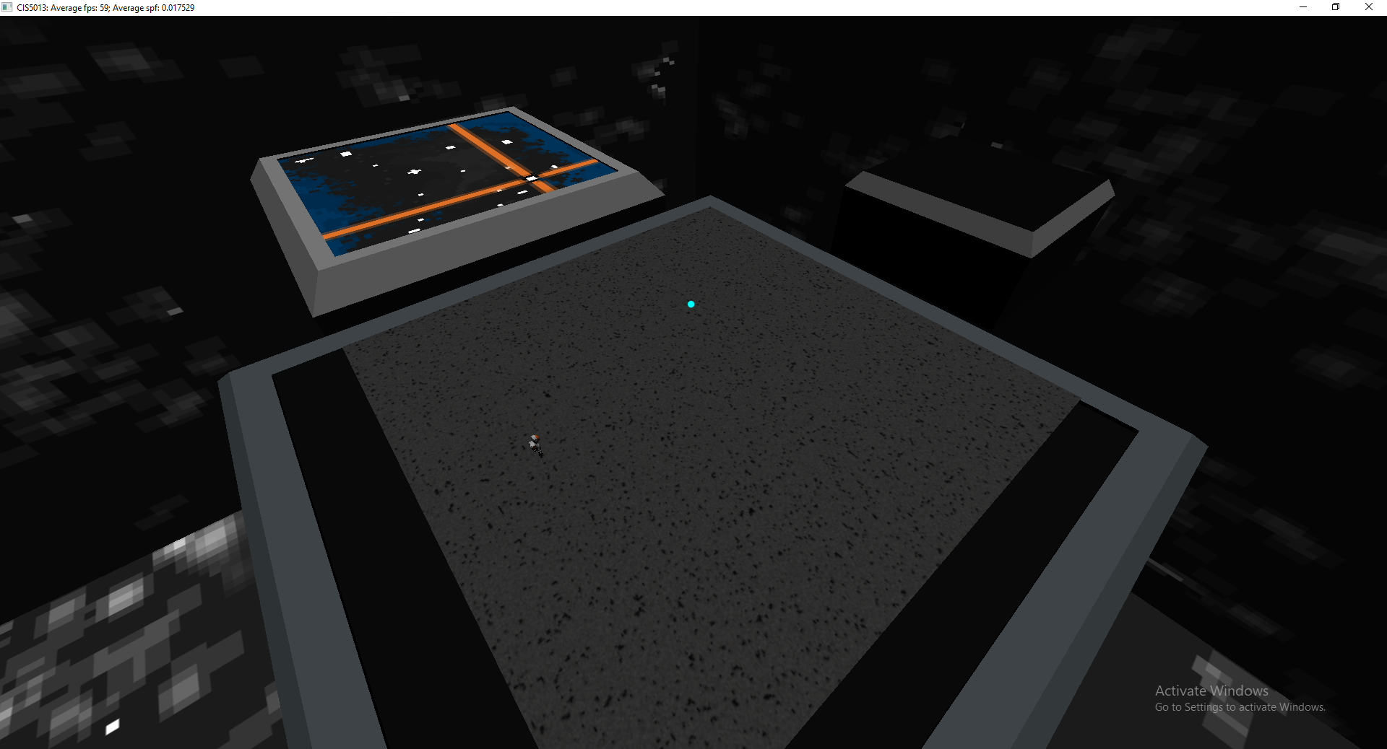
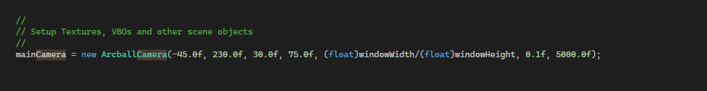
Isometric

Slide 20
05
Scenes

Slide 21
